Slide 1

Internship
WEBCORESTONE SOFTWARE SOLUTION

Slide 2
Agenda
Internship Student Detail
Company Background
Internship Over
Our services
Roles And Responsibilities
Some Implementations
Training Details

Slide 3
Internship student details
Student Name Shivam Naik
Company Name Webcorestone software solution
Internship Duration 6 Months
Mode Offline
Working Day Monday - Saturday
Position Intern
Role Web Application Developer

Slide 4
Company Background
Webcorestone software solution development company, we create digital solution for international corporations , small businesses .
Webcorestone Software Solution as a dedicated team of hardworking and committed skilled professional. The people at Webcorestone continuously strive to attain knowledge and increase their talent to provide the best quality solutions to our valued customers.
Our Priority is to Fulfill all Requirements of Clients & Deliver Best Software to their Needs . We Build Mobile Applications, Web Applications According to Exact Clients Demands.

Slide 5
Internship Overview
Background
Internships provide practical experience in real-world environments.
They help build a competent resume and offer visible work experience.
Duration typically ranges from three to twelve months.
Interns explore their field of interest and assess career paths.
Provides new perspectives and learning opportunities.
Enhances capability to apply therotical understanding to real-world scenarios.
Assists with career development in diverse fields.
Provides vital work experience and develops relevant skills.
Purpose of Internship

Slide 6
Our Services
Software Development
Web Development
Application Development
Cloud Computing

Slide 7
Our Features
Very Customisable
Ready to use, out-of-the-box. Match business process to support workflows.
Collaboration & Teamwork
Collaborate effortlessly. Group to work together towards a common goal
Customer Satisfaction.
We can’t grow a sustainable business without happy customers.We work hard to improve
customer satisfaction here.

Slide 8
Work Updates
How to clone project using GitHub.
Pull the branch .
Making own branch.
Add code and commit.
Push the code to main branch.
Resolving Merge conflict.

Slide 9
Learning And Growth
Training in python script
Oops concepts.
Variables and data types.
Operators and expressions.
Introduction to Django.
Function parameters and return values.
Writing Django Rest API.

Slide 10
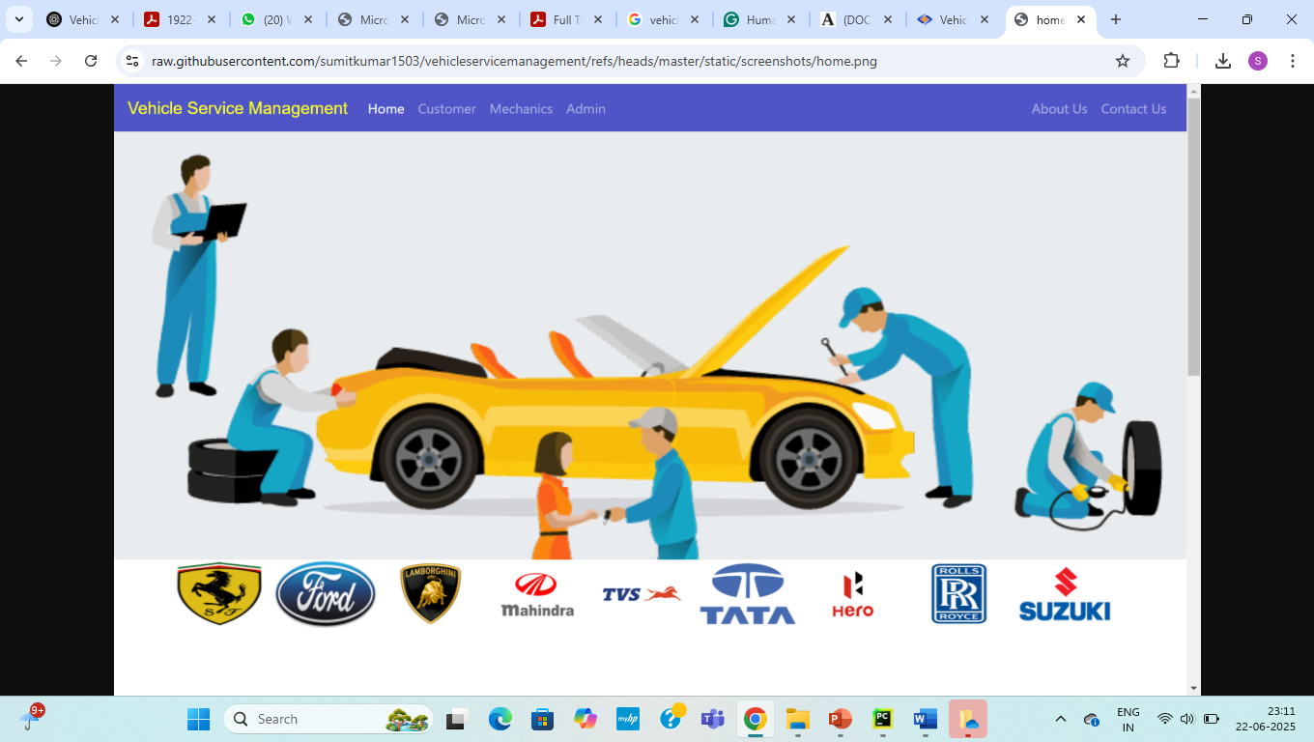
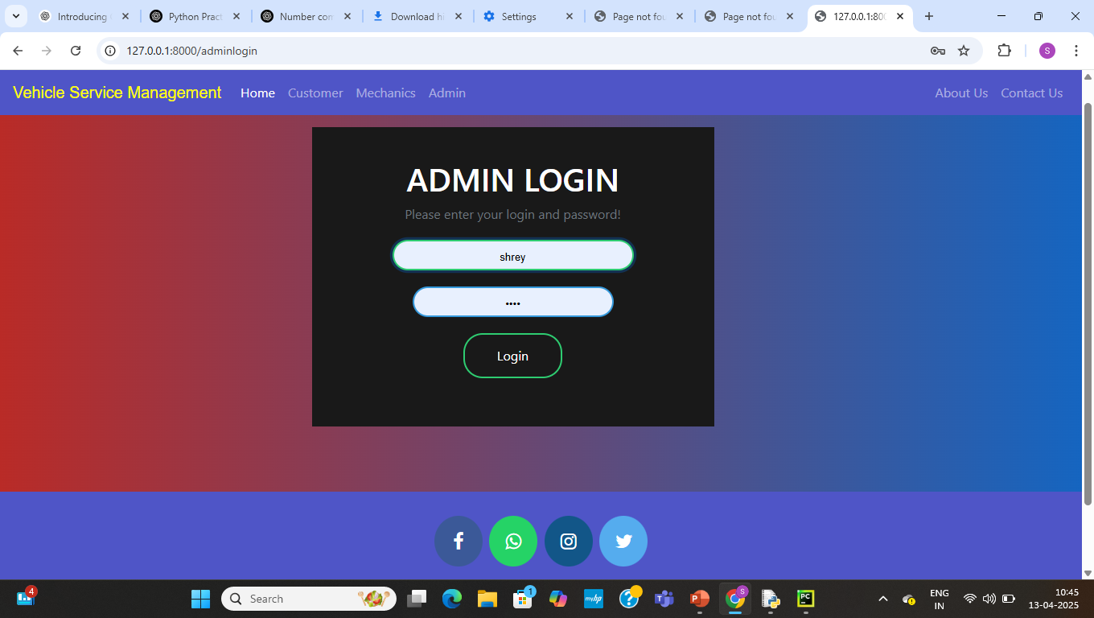
Implementation
Home page
Admin login

Slide 11
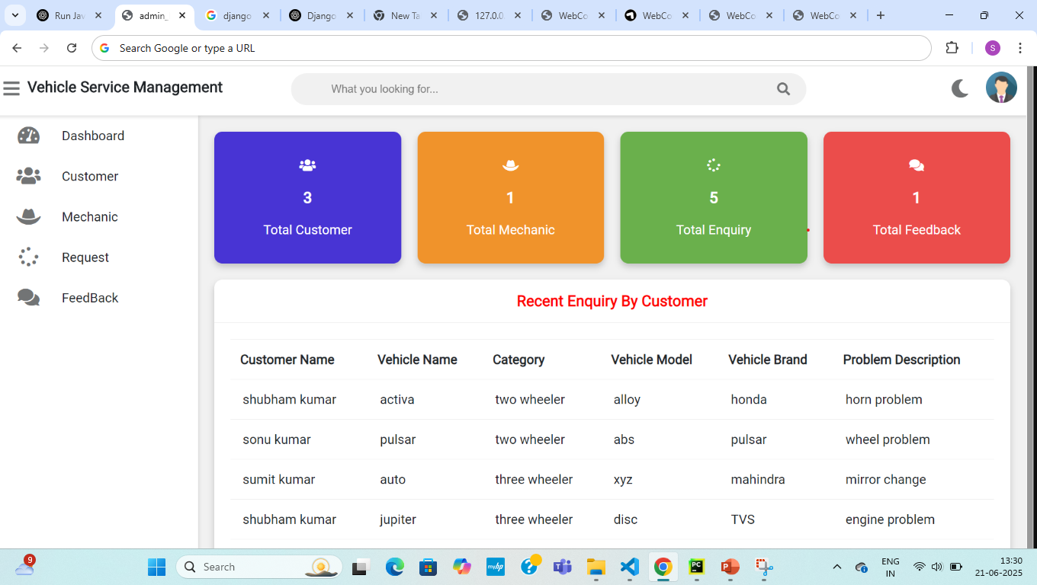
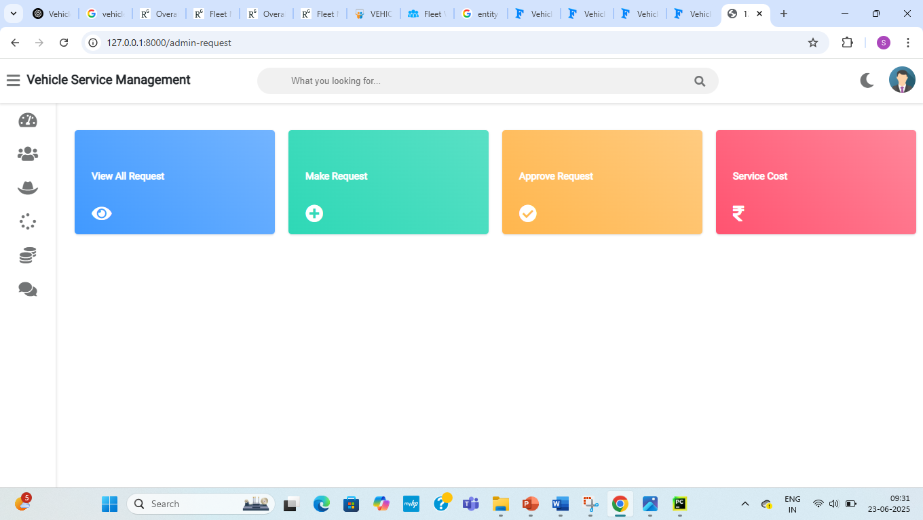
Implementaion
Admin Dashboard
Request Dashboard

Slide 12
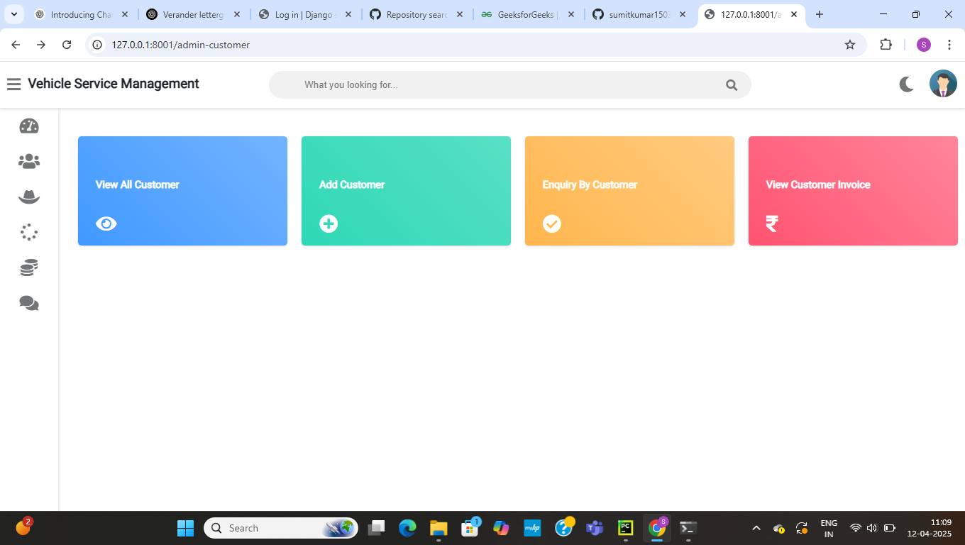
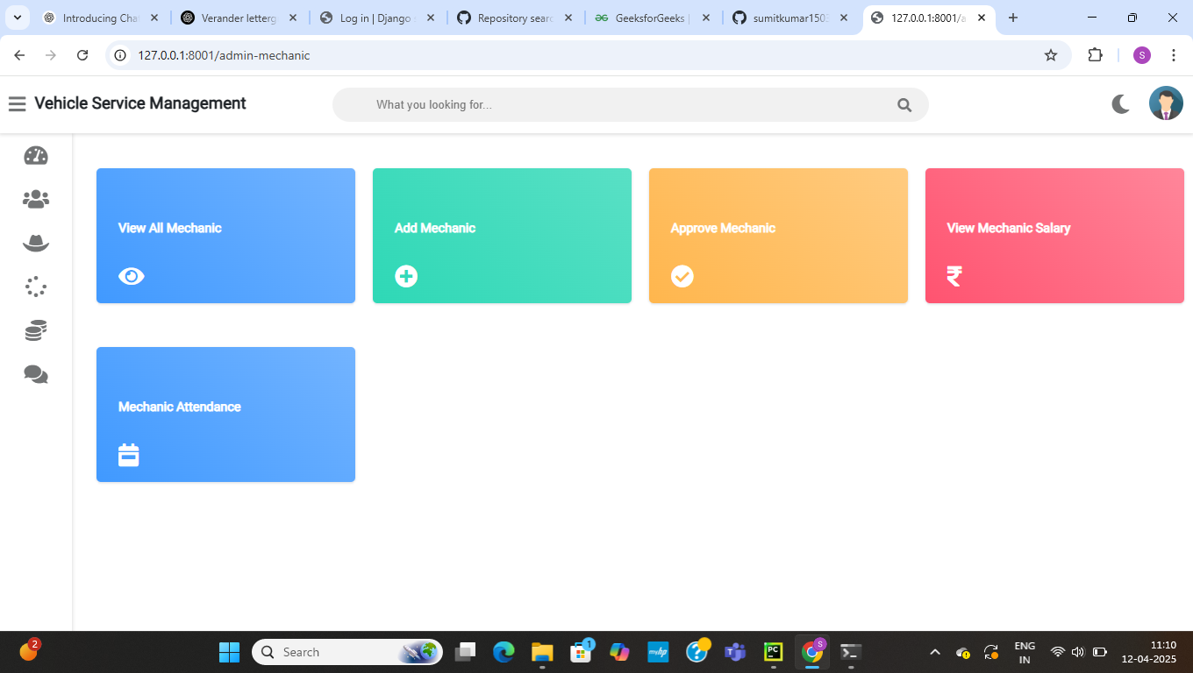
Working
Customer Dashboard
Mechanics Dashboard

Slide 13
Skill Training
python , GitHub , Django
Working with GitHub
Problem Solving in Real Project Environment handling exceptions.
Improved Technical and Communication Skills

Slide 14
Conclusion
My internship at WEBCORESTONE SOFTWARE SOLUTION was a valuable and rewarding experience that gave me hands-on exposure to real-world web application development.
I had the opportunity to work on backend, gaining practical knowledge of modern tools and frameworks like Django and REST APIs.
This internship not only helped strengthen my technical skills but also improved my ability to collaborate in a team, solve problems independently, and adapt to fast-paced environments.

